Slide 1
Inertia
Game pitch

Slide 2


Slide 3
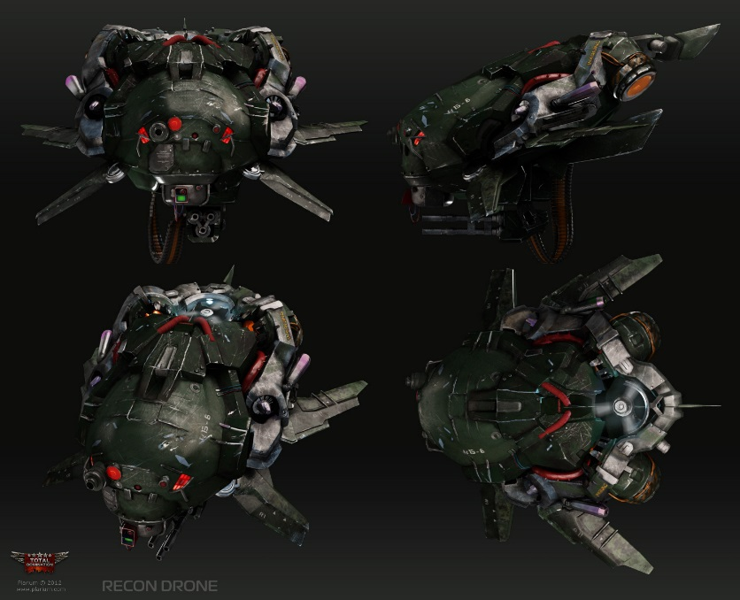
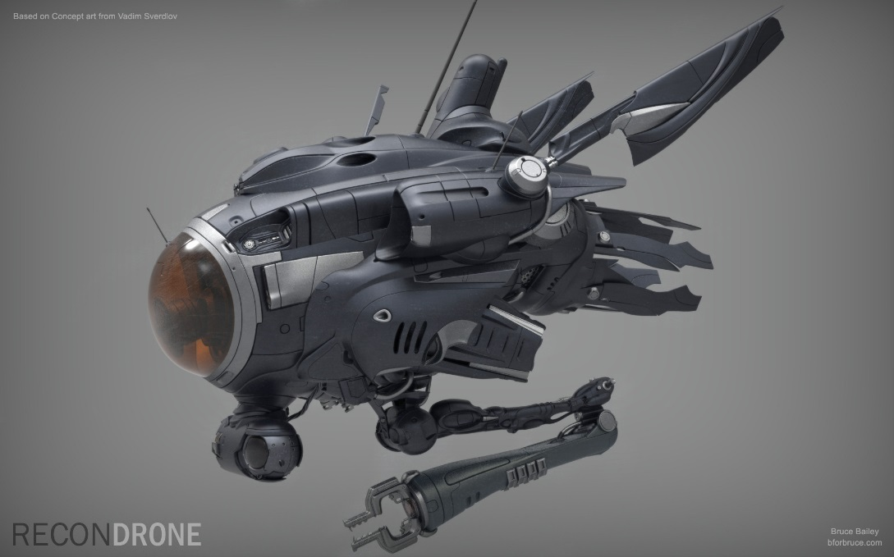
Synopsis
A top down, 3D, local multiplayer fast paced arena combat game about remote controlled drones fighting each other in a zero gravity environment. Players must learn to use their thrusters to maneuver around the environment. The game has a one shot one kill attitude when it comes to damage so situational awareness is key to success.

Slide 4
Mechanics
Movement
Inertia is set in a zero-G environment. Movement in a zero gravity environment is different to, for example, the way we move on Earth. Here, if we throw a ball it will be affected by many factors such as wind and gravity. In zero-G most of these do not come into play. So, if you throw the same ball it will go on perpetually until some external force acts upon it.
Players can thrust their drone to move them in a direction, or to oppose a pre-existing movement. The diagram on the next page outlines how this works.

Slide 5
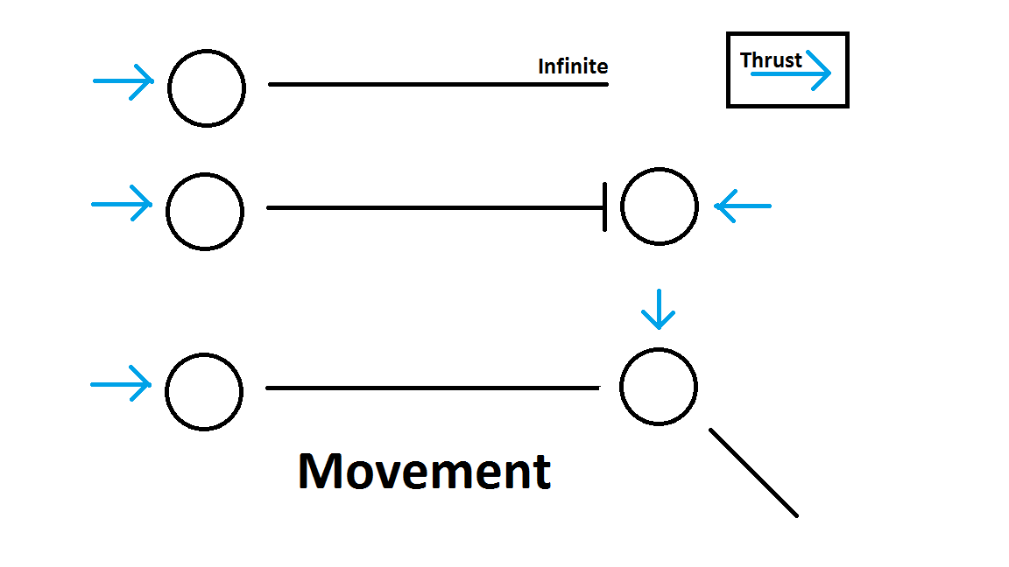

Slide 6
Mechanics Cont.
Shooting
The drones shoot a pulse rifle that is mounted on their hull. It has a somewhat lengthy cooldown that will stop the spamming of projectiles. Shooting will simulate the reaction to recoil in zero gravity.
Boosts are scattered throughout the level. They will instantly recharge your pulse rifle’s cooldown.
Abilities
Each player can have a single active ability. For example, it could be a shield wall or a gravity bomb. Each ability has their own rules. For example, the shield wall spawns a wall that will soak up one shot and then disappear. Abilities have lengthy cooldowns.

Slide 7
Mechanics Cont.
Colliding
When a drone collides with an object in the environment, rather than dying the drone’s weapon cooldown timer resets. If the object is not tied down i.e. a crate, it will float through the map.
Environmental hazards
Environmental hazards such as electromagnetic fields will kill the player if they wander into them.

Slide 8
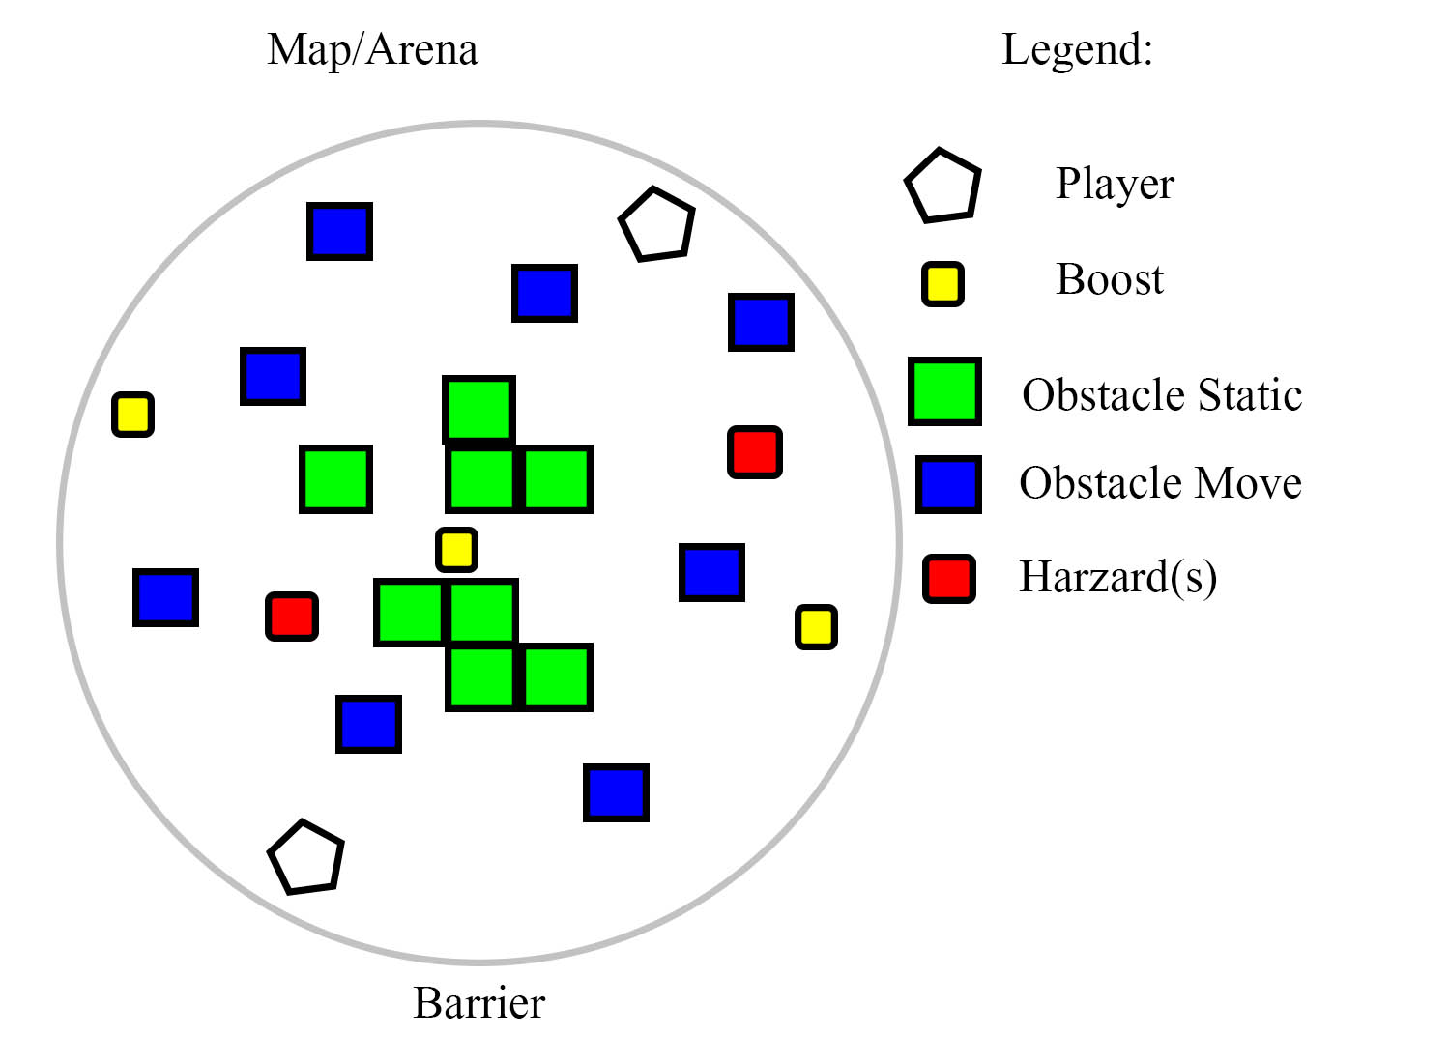
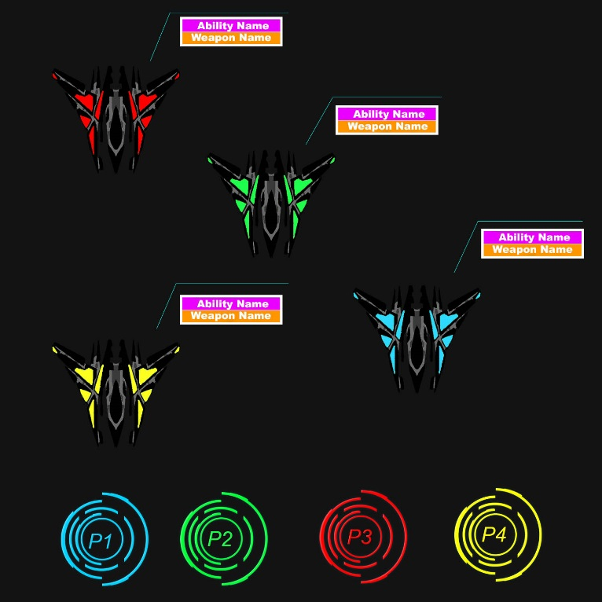
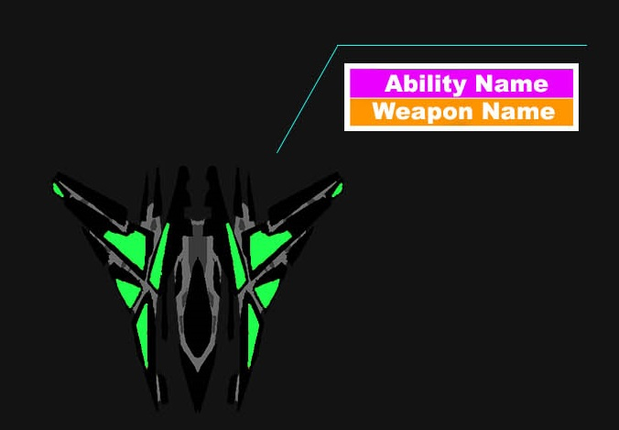
Gameplay Example
Right: the arena where the action will take place.
Below: UI Example

Slide 9





Business model
Price: The game will be premium with no micro transactions.
Platform: PC (Steam, Humble Store, GOG), PS4 (PlayStation Store), Xbox One (Xbox Live)

Slide 10
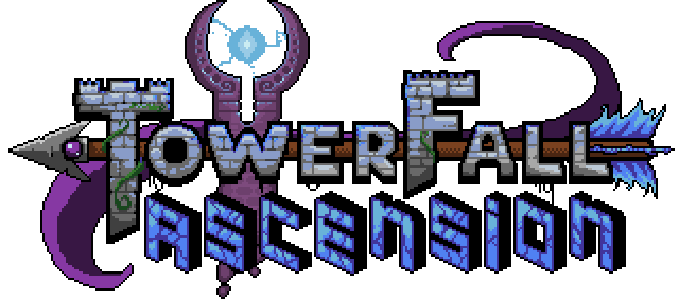
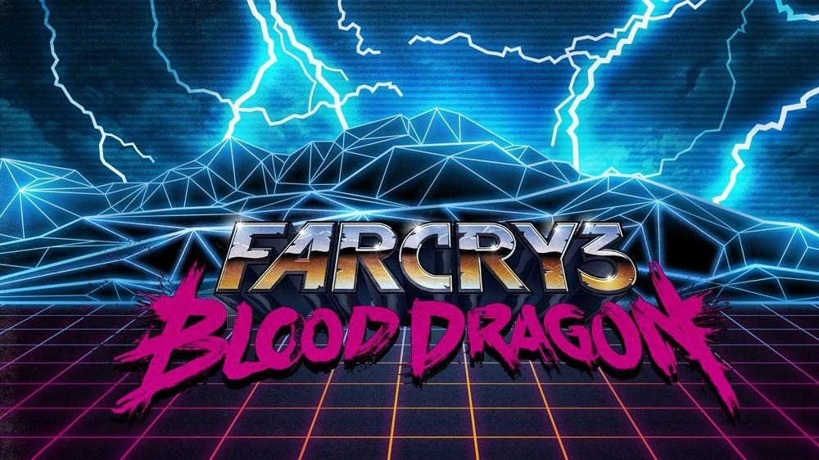
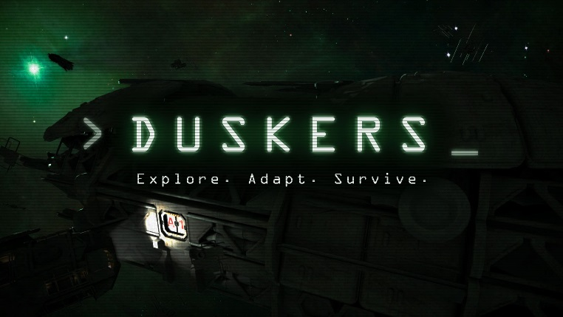
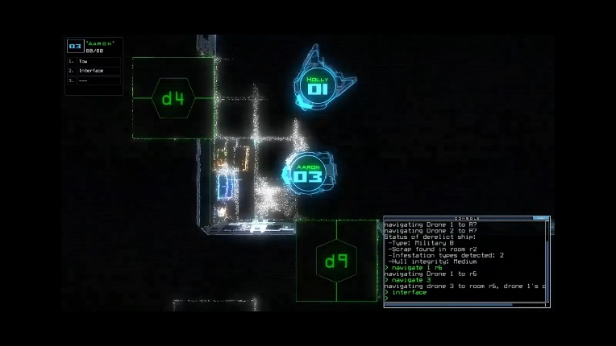
Competitive analysis
Towerfall shares the same one shot one kill gameplay mechanic. People will draw similarities to that and the quick-fire rounds.
Farcry Blood Dragon was a big inspiration for the aesthetic style, especially the visuals and the audio.
And Duskers for the aesthetics and the ‘in the cockpit’ feel.

Slide 11


Target Audience
The audience I am reaching with this game is the core and mid level player base, although the game doesn’t isolate itself from the casual gamers either.
It would take off on YouTube or Twitch as other comparable games such as Duck Game and Towerfall Ascension.

Slide 12
Control Scheme
Keyboard + Mouse Gamepad
Thrust Left = ‘A’ ‘L Joystick Left’
Thrust Right = ‘D’ ‘L Joystick Right’
Thrust Forward = ‘W’ ‘L Joystick Up’
Thrust Backward = ‘S’ ‘L Joystick Down’
Aim + Rotate = ‘mouse’ ‘R Joystick’
Shoot = ‘LMB’ ‘L Trigger’
Use Ability = ‘RMB’ ‘R Trigger’
Info Panel = ‘MMB’ ‘R Joystick In’

Slide 13
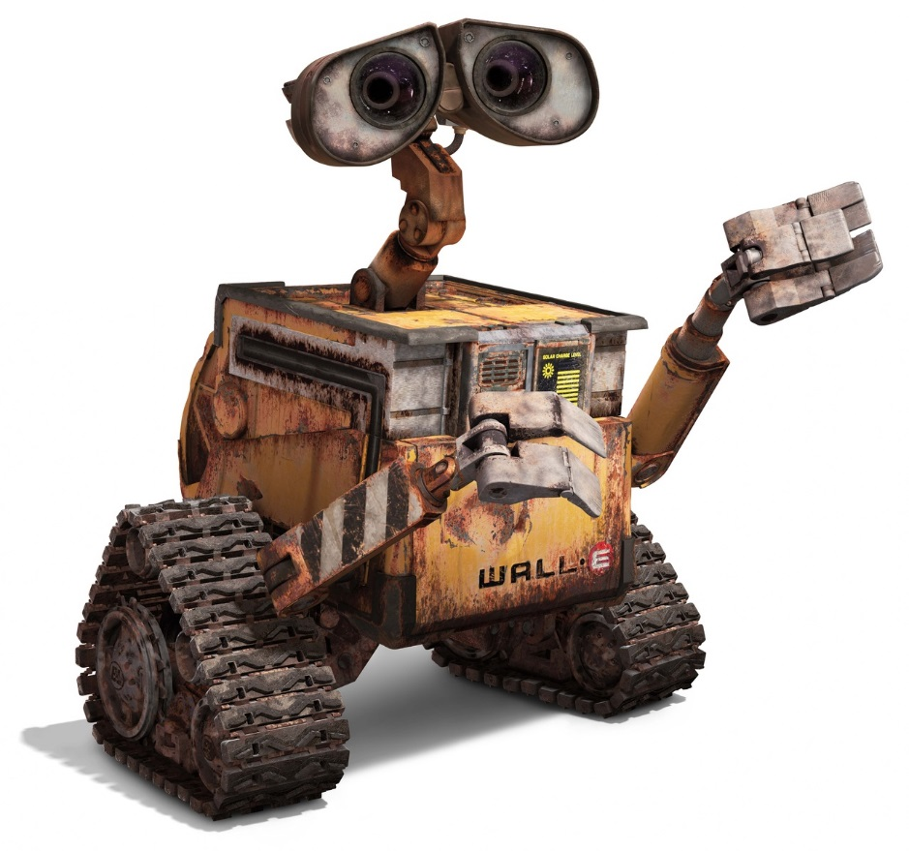
Thank you for your attention

